Slide 1
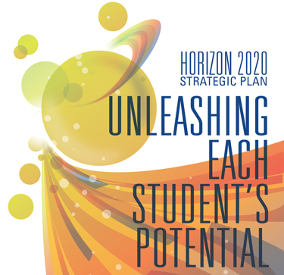
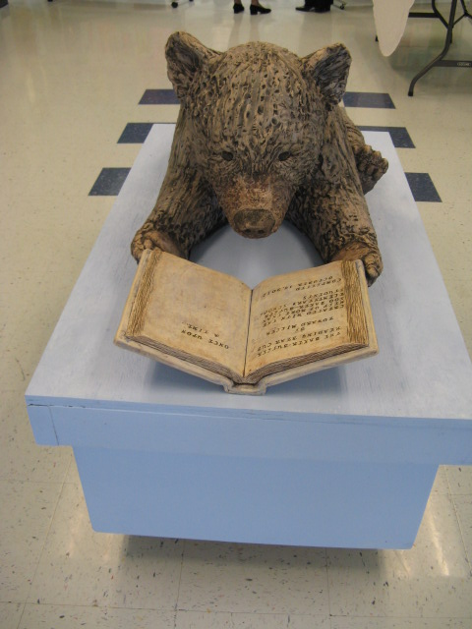
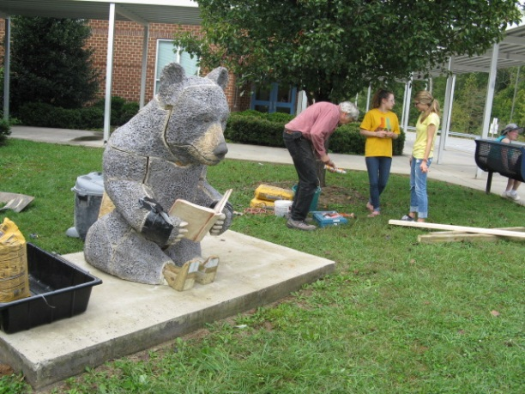
Baker-Butler Elementary School Improvement Plan
Presented By: David Cushman
Date: February 13, 2014

Slide 2
2013-14 Improvement Goals
All BBES students will attain at least one-year’s growth in Reading and Math.
Professional Development connecting Reading and Math instruction with STEAM, LLC and 7-Pathways to Student Learning.
Student emotional and physical safety will be enhanced through structures that reduce negative behavior and incidents of bullying.

Slide 3
Why These Goals are Important
Foundation:
  Student success and opportunity as 21st century learners, workers and citizens.
Engagement:
  Engaging, continuous improvement for adult and student learners through engaging work, unique experiences and varied learning environments.
Community:
  Positive learning environment supported by safety awareness, anti-bullying practices and good citizenship.

Slide 4
Current Challenges
The jobs of tomorrow are known only to the future.
Instilling an urgency in stakeholders to equip young learners with tools and knowledge to meet the challenges of a competitive global economy.
Ensuring that students are empowered to own their future by emphasizing Lifelong Learner Competencies and providing varied learning environments, essential tools of contemporary learners and unique experiences and opportunities.
Continuous academic progress for all students – all means all.
  Successive student population shifts
  Support for RTI Tier I, II, III students
  Increase reading and math performance for AMO groups 1, 2, 3
  Homework completion
  Attendance
  Parent involvement
  Common understandings of the most effective math and reading instruction strategies.

Slide 5
Current Successes
Improved monitoring and follow through of students who are habitually tardy or absent:
  Attendance committee reviews progress
  Attendance clerk prepares attendance and tardy data
  Administrators follow up with parents - letter, phone call, meeting, JDC
Partnering with parents to increase the level of family involvement in school activities and support for student work:
  SBIT meetings, PTO events, curriculum nights, “School and Community Friendship Network.”
Assessing one year’s growth using multiple measures that can be mutually verified to affirm student progress:
  Student progress in reading and math for all students in grades K-5 was reviewed at Midyear Review meeting on February 6th, 2014.
  New RTI pilot streamlining process, universal screeners, progress monitoring
  Balanced assessments using benchmark tests, portfolios, performance tasks, etc.
  Varied presentation modes – story, poem, article, letter, song, art work, poster, technology enhanced, etc.

Slide 6
D2015 Challenges
Design 2015
  Establishing a shared outcome using STEAM as the core.
  Creating a tipping point with staff through organization of a Design Team that models PBL work.
  Envisioning and embracing Maker Education.
  Developing common understandings of D2015 attributes that build instructional capacity with all staff.
  Connecting D2015 directly to PBL work accomplished by Design Team members establishing a portfolio of exemplars that can be used for study and reflection by all staff.

Slide 7
D2015 Successes
A Design Team was trained over the summer:
  Content integration, STEAM, and D2015 pathways.
Pre-service week training for all teachers:
  STEAM – project based, passion based learning
  7-Pathways to Student Learning
  Lifelong Learner Competencies
Professional Development:
  Reading PD on September 30th, 2013 with D2015 emphasis
  Math PD on February 17, 2014 with D2015 emphasis
  Making connections conference, fall, 2013
  ARC offerings in 7-Pathways
  Re-envisioning what it means to be a maker culture
  School visits – Crozet, Brownsville, Henley, Stony Point
  Students renaming the STEAM room to “Creation Station”
D2015 is integrated with curriculum…
…it is not something confined in a separate room.

Slide 8
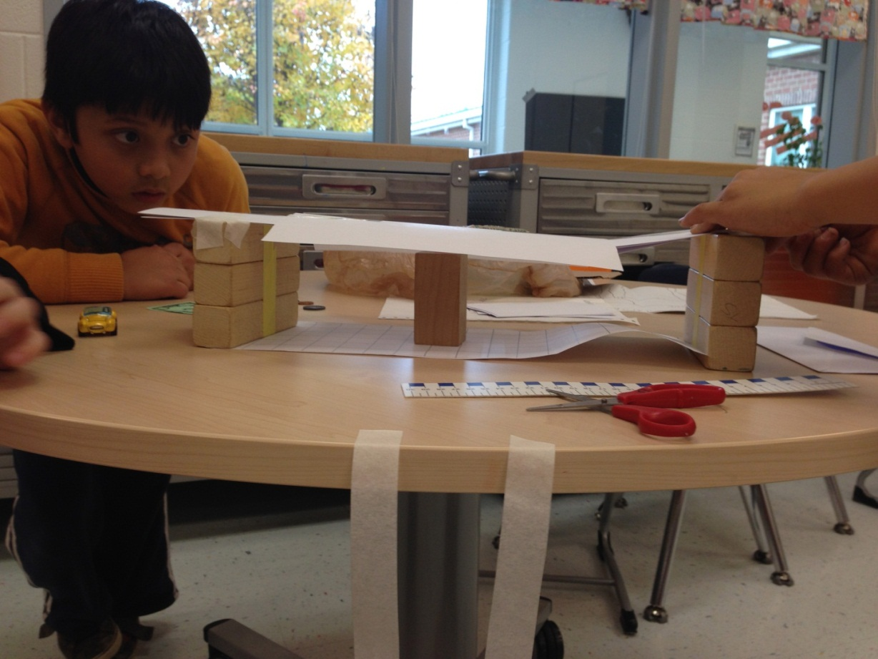
Authentic Problem Solving
Measured
Risk
Taking
Maker Learning is engaging in creating, designing, exploring, invention and problem solving.
Project Based, Passion Based Learning – higher order, in depth learning by engaging in a multi-step project.

Slide 9
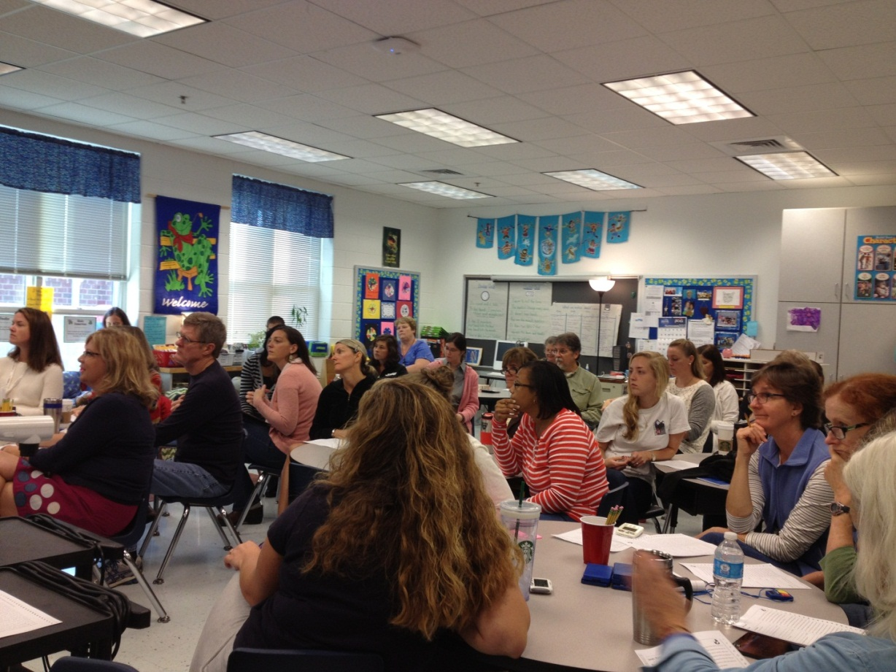
Professional Development
Educators and Lifelong Learning
~Leading by Example~
  Design 2015
  STEAM
  Seven Pathways to Student Learning
  Lifelong Learner Competencies
  Reading strategies
  Math strategies
  Olweus BPP
  Responsive Classroom

Slide 10
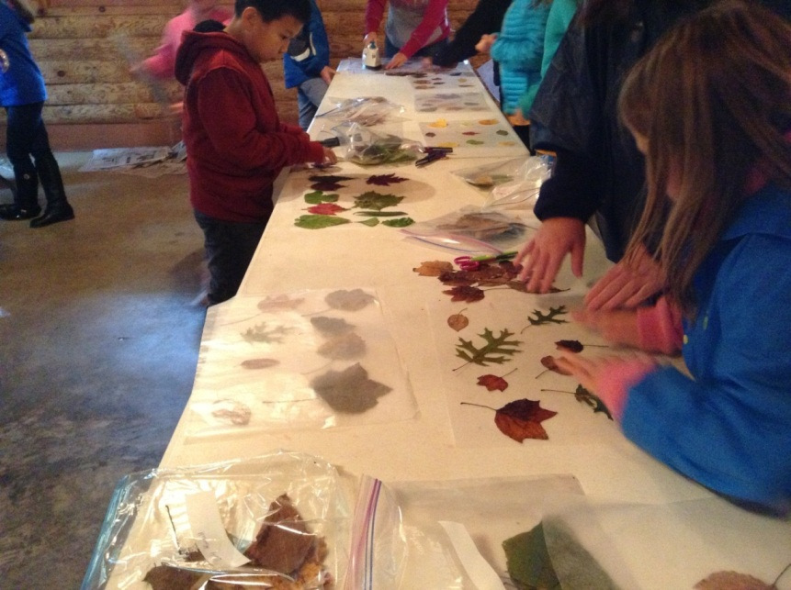
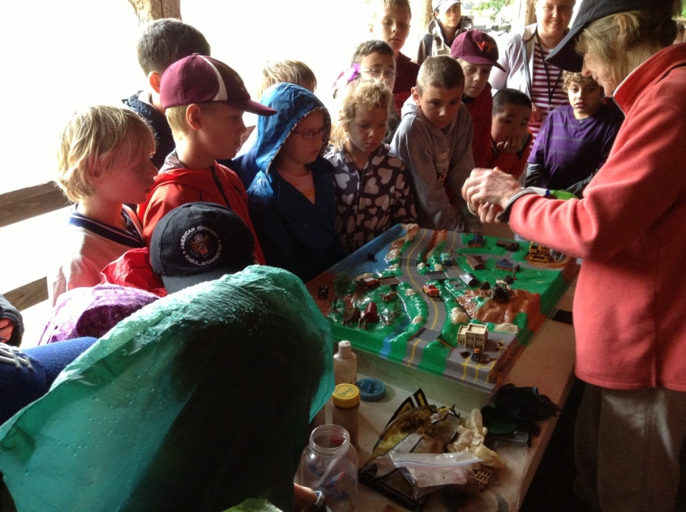
Experiential Learning Encourages Cooperation and Sense of Community
Learning together
Problem solving together
Uniting learners
Having common goals
Risking failure to learn from mistakes
Cooperating
Respecting
Valuing others

Slide 11
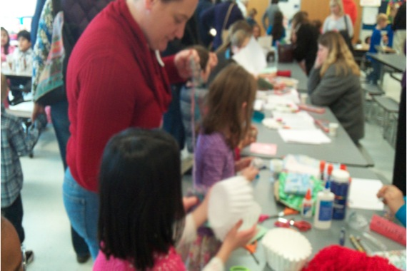
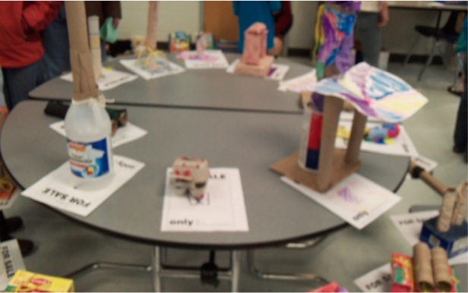
All means all
“Kid Town”
Real World Simulations

Slide 12
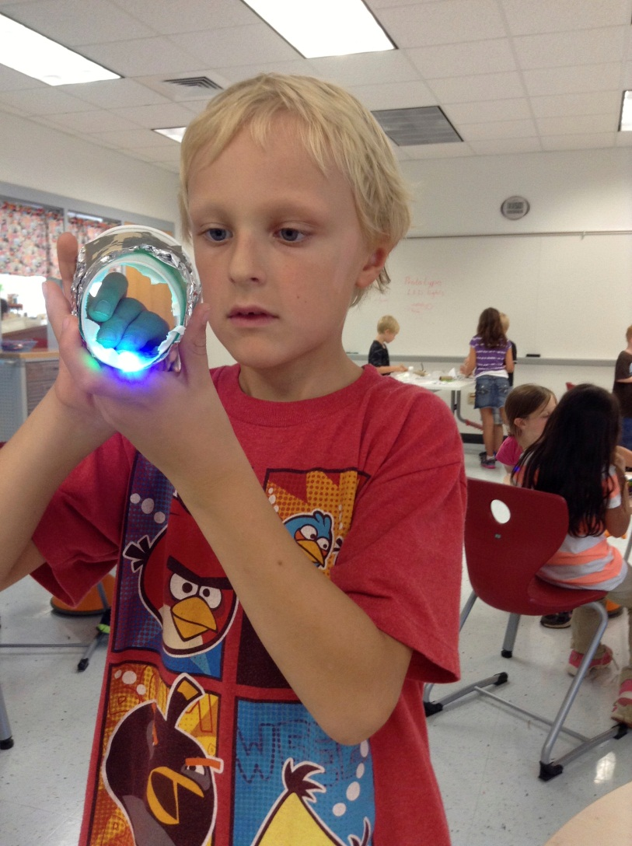
LED Light Design
Our Successes will Become the Norm

Slide 13
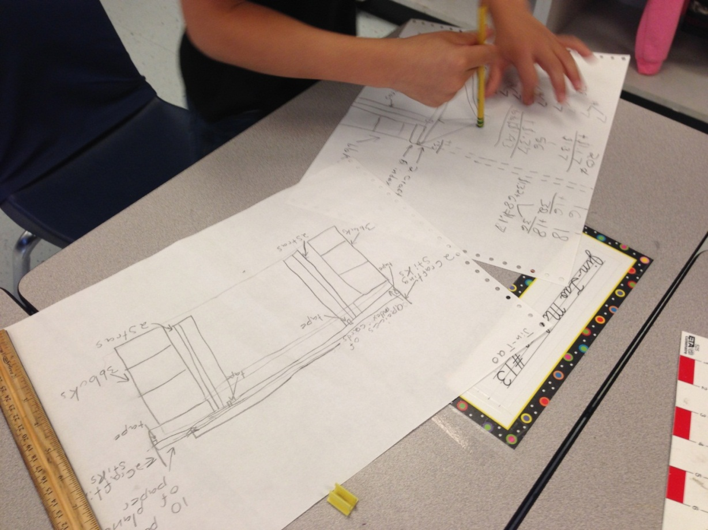
STEAM and
Maker Education
Integration of content: “STEAM”
Science
Technology
Engineering
Arts
Math

Slide 14
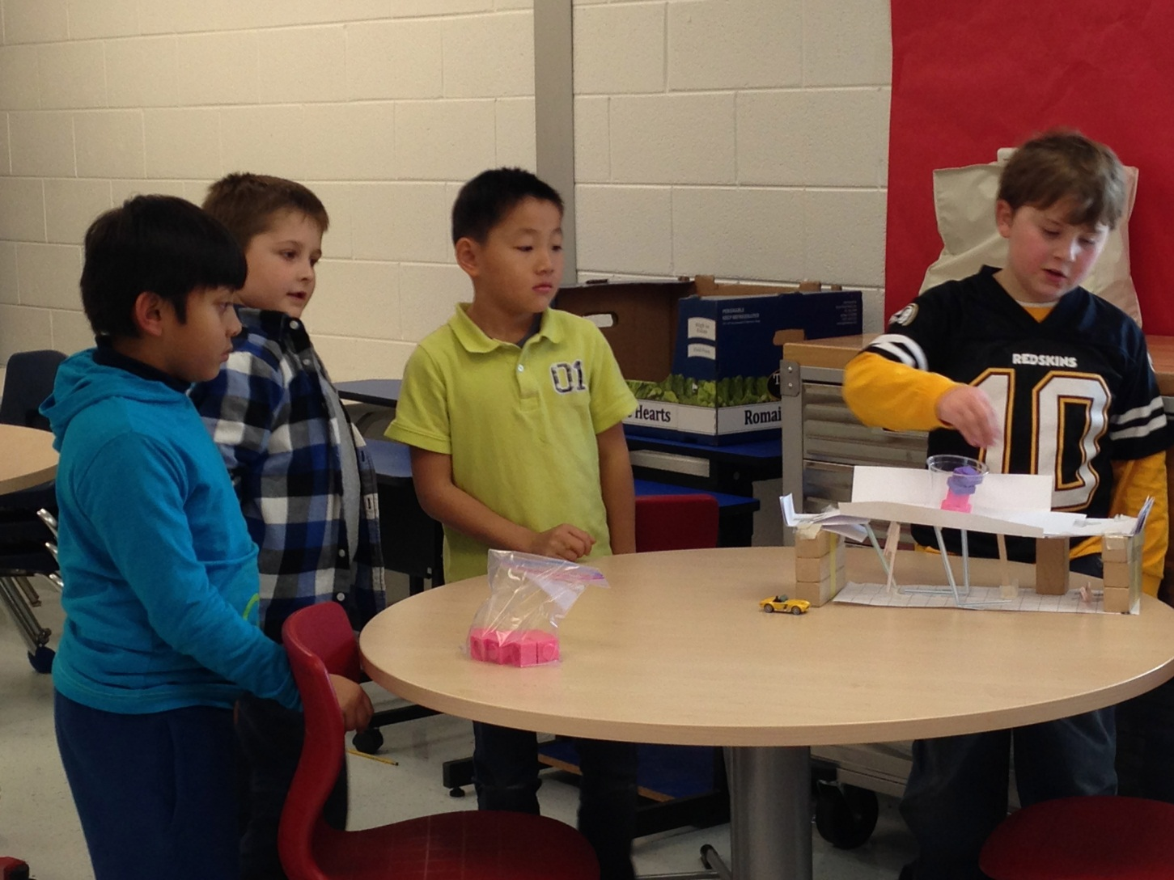
Bridges Engineering Project
LLC – Habits of Mind

Slide 15
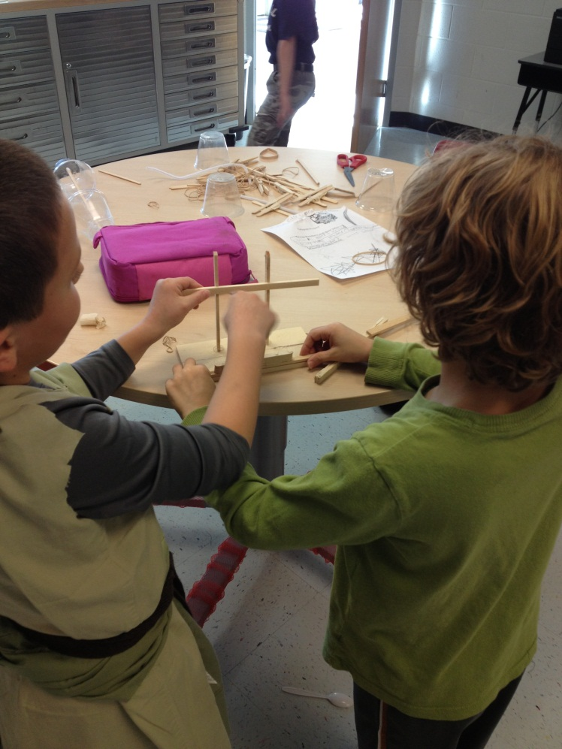
Lifelong Learners
Collaboration
&
Metacognition

Slide 16
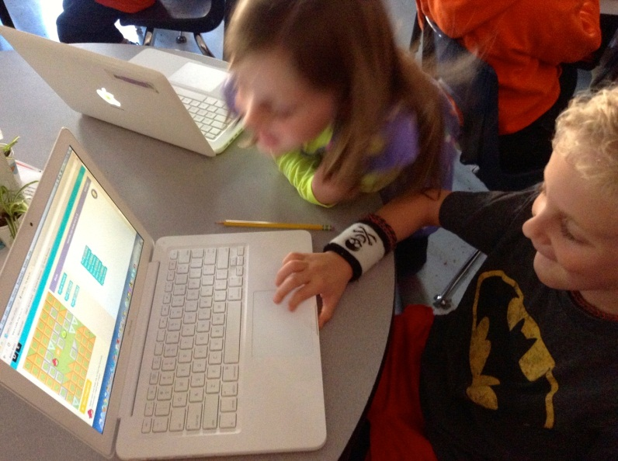
Beginning Computer Coding
“Hour of Code”

Slide 17
Lifelong Learner Competencies
Scratch Coding
After School Club
Acquire and use precise language to clearly communicate ideas, knowledge and processes.
Explore and express ideas and opinions using multiple media, the arts and technology.

Slide 18
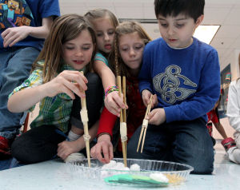
Chinese Festival
“…THIS is the way to learn about China!” – BBES parent
Silk Worm Races
CDP 0206 Chinese260.JPG: From left, Maylin Dudley, Cheyenne Morris, Mya Tolley and Alex Adams work on using chop sticks to grab objects representing the life cycle of a silkworm during a Chinese Festival on Wednesday at Baker-Butler Elementary School. Photo / Ryan M. Kelly / The Daily Progress - Photo by Ryan M. Kelly
Notes:
WHAT: Chinese Festival
WHEN: Wednesday, February 5, 2014, from 12:30 to 1:45 p.m.
WHERE: Baker-Butler Elementary School
2740 Proffit Road, Charlottesville, VA 22911
WHO: Baker-Butler’s second grade students
HOW: As part of their study of Ancient China, Baker-Butler second grade students will usher in the Year of the Horse on Wednesday, February 5, 2014. Students and their guests will enjoy authentic Chinese foods at a special New Year’s luncheon. This will be followed by a festival of engaging activities and projects, which will include Chinese ribbon dances, Tai Chi, silkworm life cycle races, tangram art, and scroll painting. Students will work collaboratively to create a large Chinese dragon as a culmination to their celebration of the Chinese New Year.
CDP 0206 Chinese260.JPG: From left, Maylin Dudley, Cheyenne Morris, Mya Tolley and Alex Adams work on using chop sticks to grab objects representing the life cycle of a silkworm during a Chinese Festival on Wednesday at Baker-Butler Elementary School. Photo / Ryan M. Kelly / The Daily Progress - Photo by Ryan M. Kelly

Slide 19
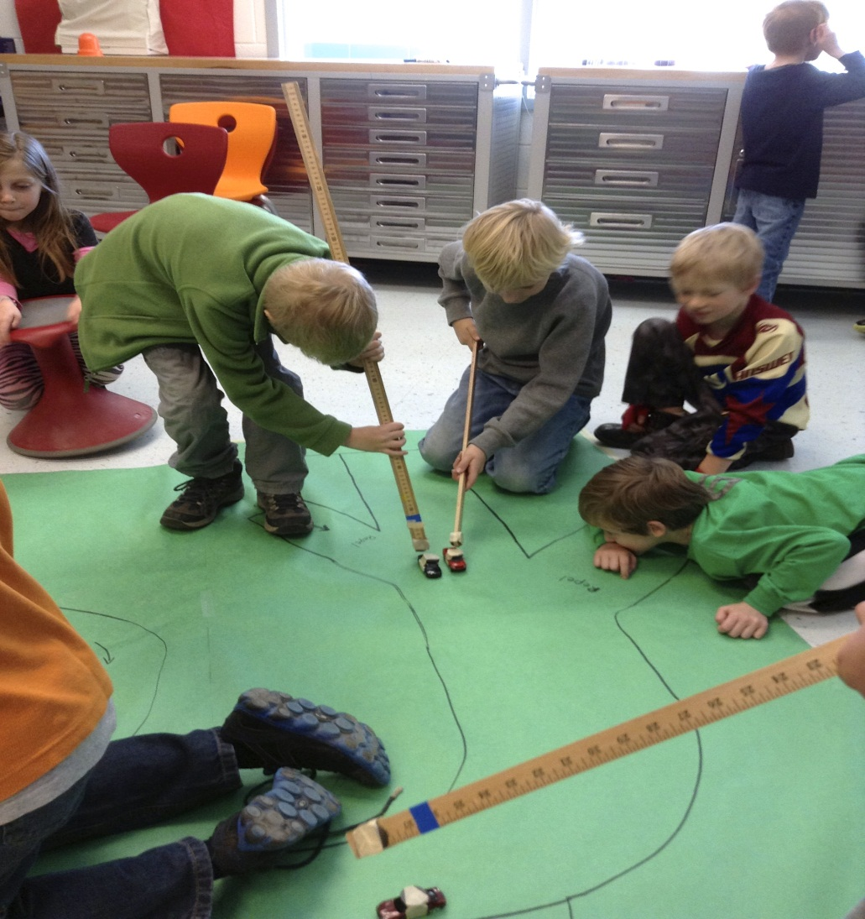
7-Pathways to Student Learning
Magnet Races
Universal Design is responding to individual needs and strengths by allowing multiple ways of accessing the curricula.
It is a lot more fun, meaningful and memorable to have a “magnet race” than to sit at a desk and read about polarity.

Slide 20
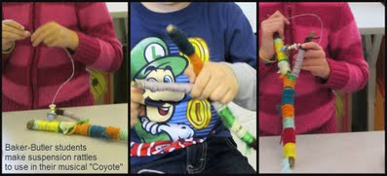
STEAM
Arts Integration & Teacher Collaboration
American Indian Suspension Rattles
Notes:
Baker-Butler 2nd Graders Perform "Coyote"
posted 21 hours agoJan 22, 2014, 12:27 PM by Cyndi Wells
Baker-Butler second graders completed their study of American Indians by performing an original musical, “Coyote” (click on the hyperlink to see highlights) based on the book by author Gerald McDermott. With the guidance of Art teacher, Karen Purdon and Music Specialists, Ashley Grundler and Donna Rehorn, the students created‘suspension rattles’ in Baker-Butler’s STEAM room, (now known as “Creation Station”) and used these rattles in their performances.
As part of this project, the students made clay pots in Art class and designed headpieces for the performance with their classroom teachers. With Mrs. Purdon’s help, the students created the set backdrop with cacti for the mesa!
The musical incorporated three pieces written by Music Specialist, Donna Rehorn. The student musicians played Orff and percussion instruments and sang about the perils of“Coyote”. Students also performed an American Indian stick game, “Gitsigakomim”. Our cast included a group of dancing crows, old man crow, badger, woodpecker, snake, Blue Coyote, Gray Coyote, and was beautifully told by three student narrators.
Coyote’s misadventures and boastfulness caused his demise and the loss of his beautiful blue coat! “Trouble! Trouble! He had a nose for trouble!"

Slide 21
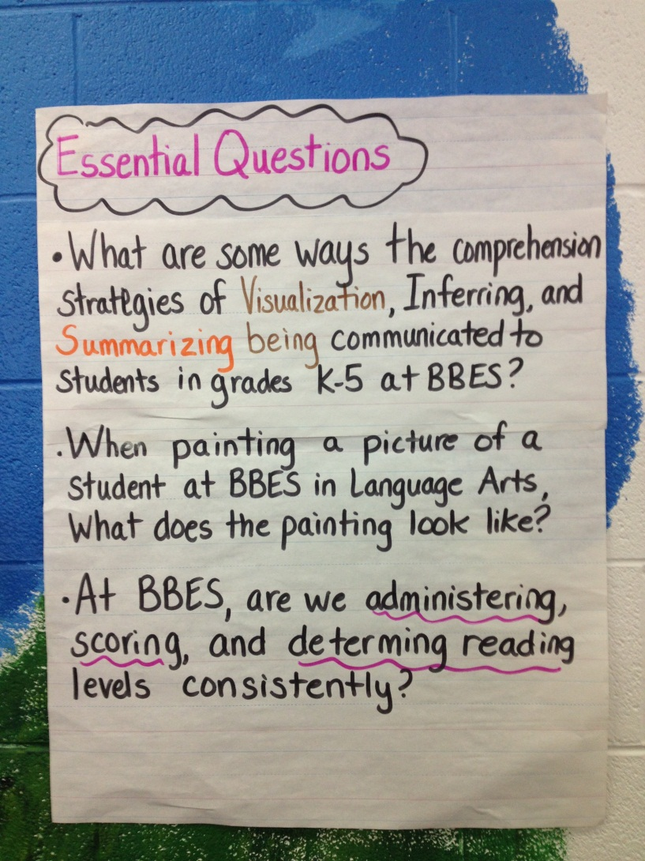
Educators leading by example with their own lifelong learning

Slide 22
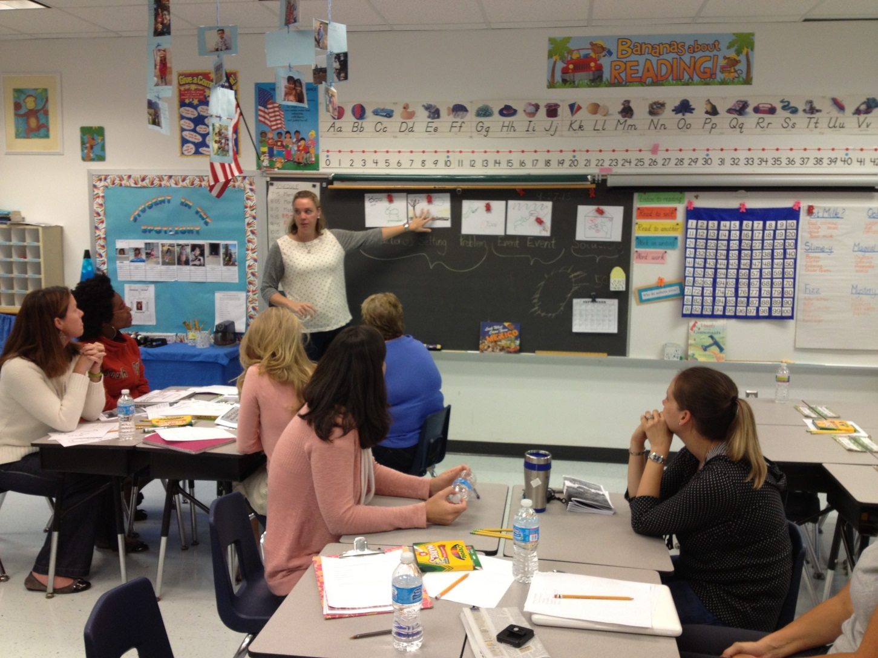
Teachers Teaching Teachers

Slide 23
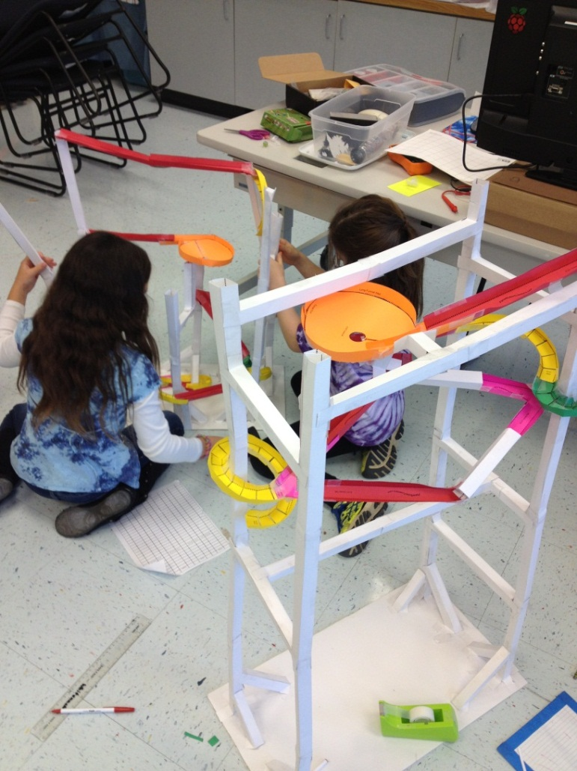
CREATION STATION
Marble Roller Coaster Challenge
Marble Run Roller Coaster Challenge
Virginia Regions Salt Dough Maps Modeling
Scarecrow Design
Columbus Day Boats
Engineering Towers
American Indian Corn Husk Dolls
Matter Day
Panda Research Project
LED Light Design
Magnet Races
Invertebrate Day
Cell Mapping Projects
Hour of Code
Biomes Discovery and Research
Flight Experiments
Survival Project
Division Project

Slide 24
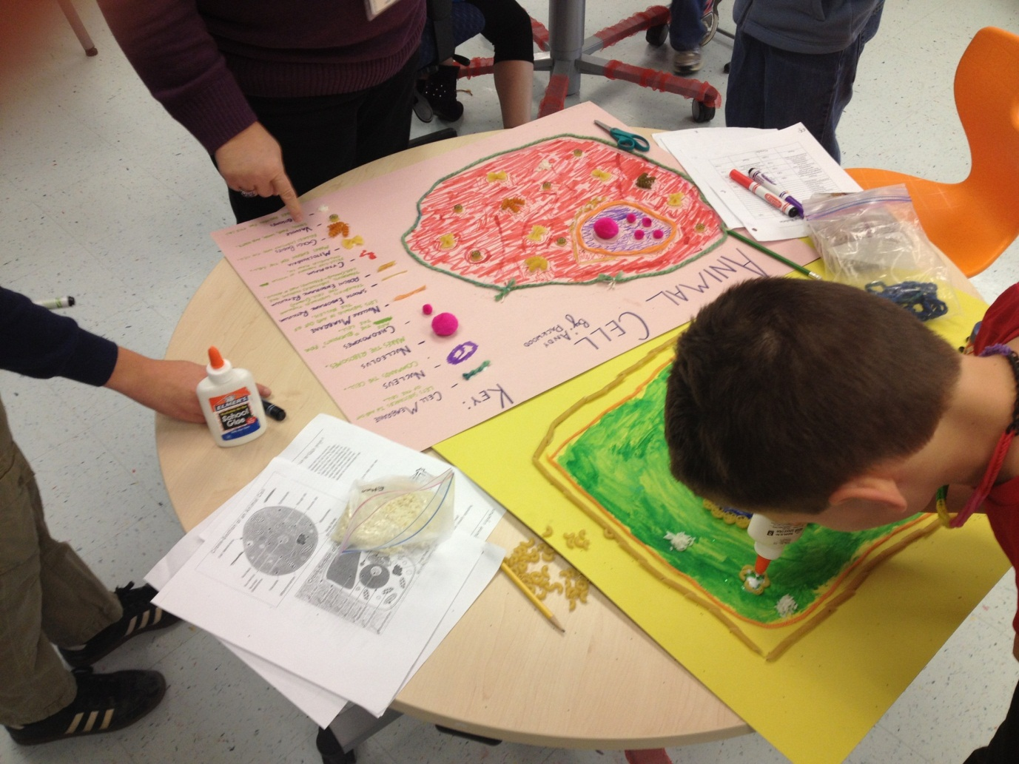
Real World Learning
Problems and Solutions

Slide 25
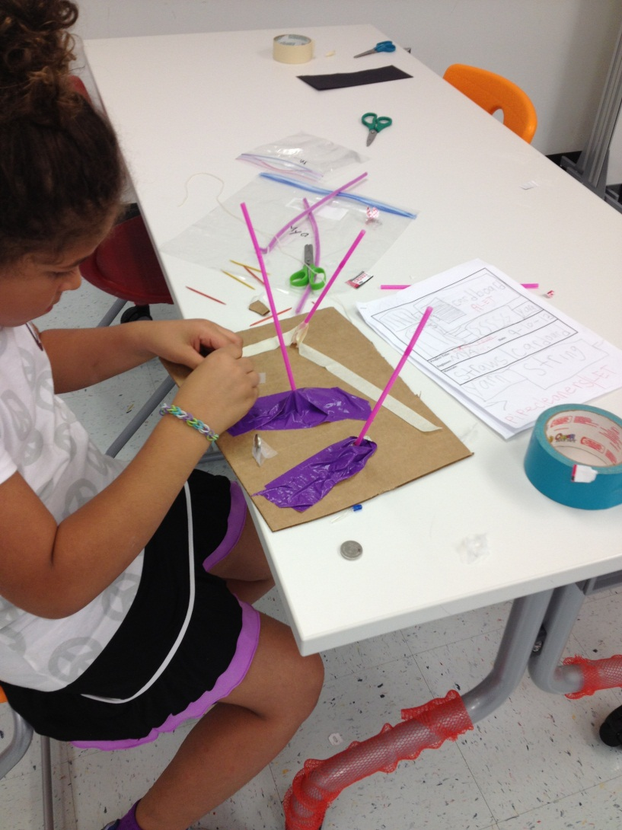
“I can make things…if I have time to think about it.” Emma P.

Slide 26
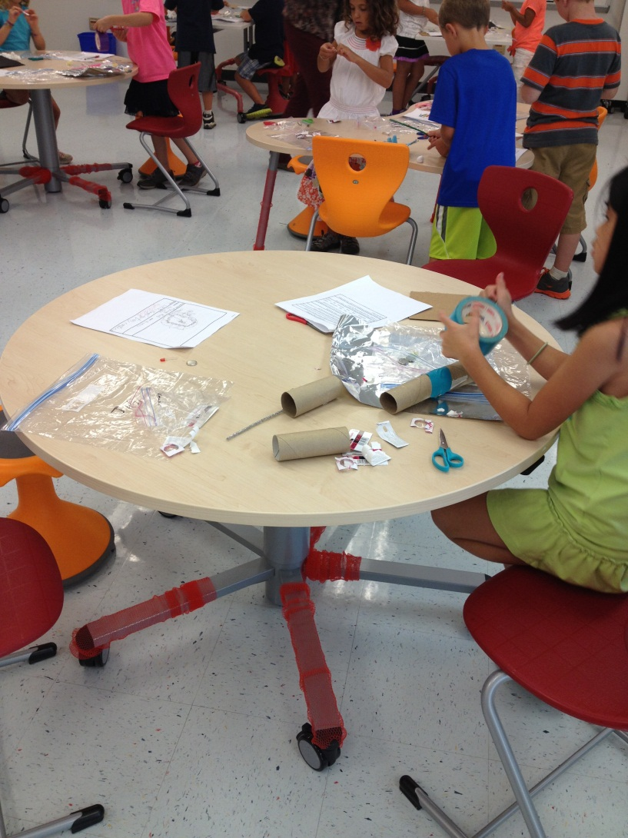
Our Students Love their new
Creation Station Learning Space!

Slide 27
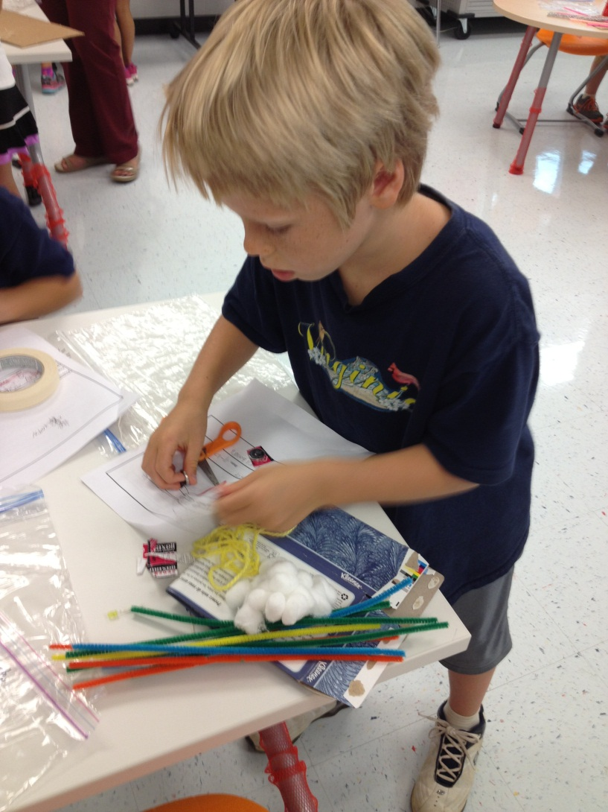
Making in Action
Maker Learning is deeply engaging to students!

Slide 28
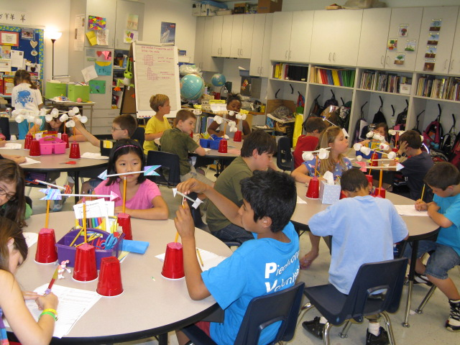
~ END ~
Thank you ACPS School Board Members!

